Slide 1


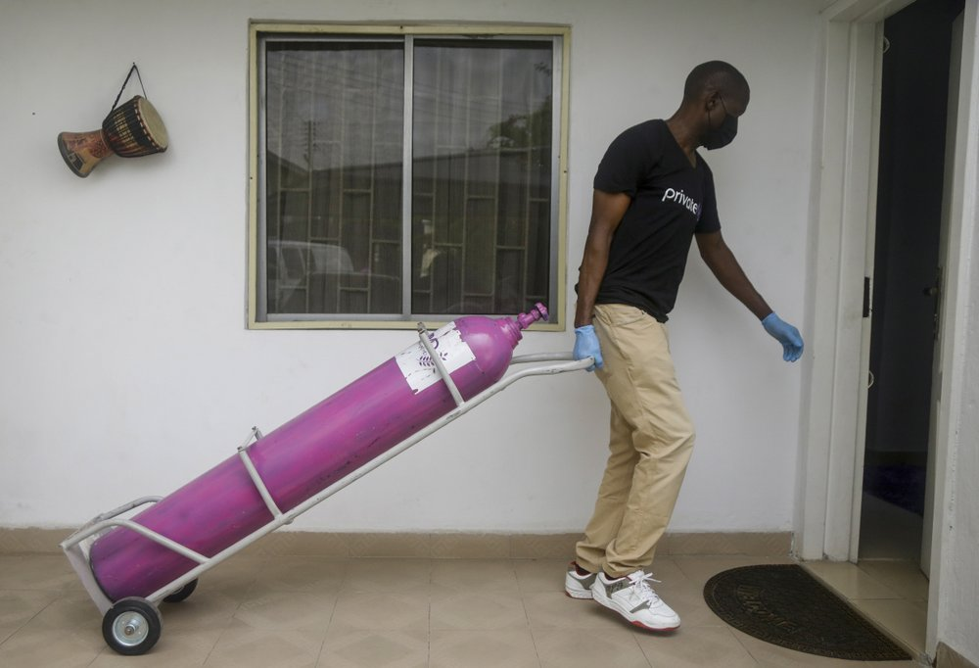
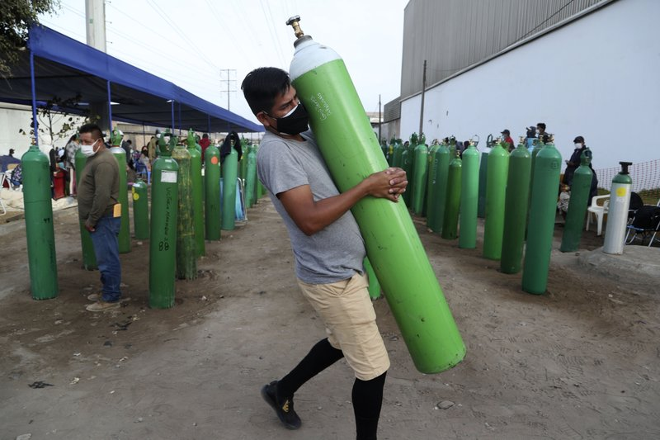
Project Apollo
Why
O2 needed for ventilators, oxygen therapy
Typical FiO2 0.3 … 0.5, up to 1
Oxygen generation is a big problem in developing countries
No established infrastructure
Oxygen bottles are expensive
People are already looking at alternative (local) ways for producing and delivering oxygen
https://www.economist.com/graphic-detail/2021/03/09/hospitals-are-running-out-of-oxygen-to-treat-covid-19-patients
https://www.cidrap.umn.edu/news-perspective/2021/03/who-sounds-alarm-over-covid-linked-oxygen-crisis
https://apnews.com/article/oxygen-crisis-africa-latin-america-eb0d2731a8613c1ae218db7d32a227a6

Slide 2
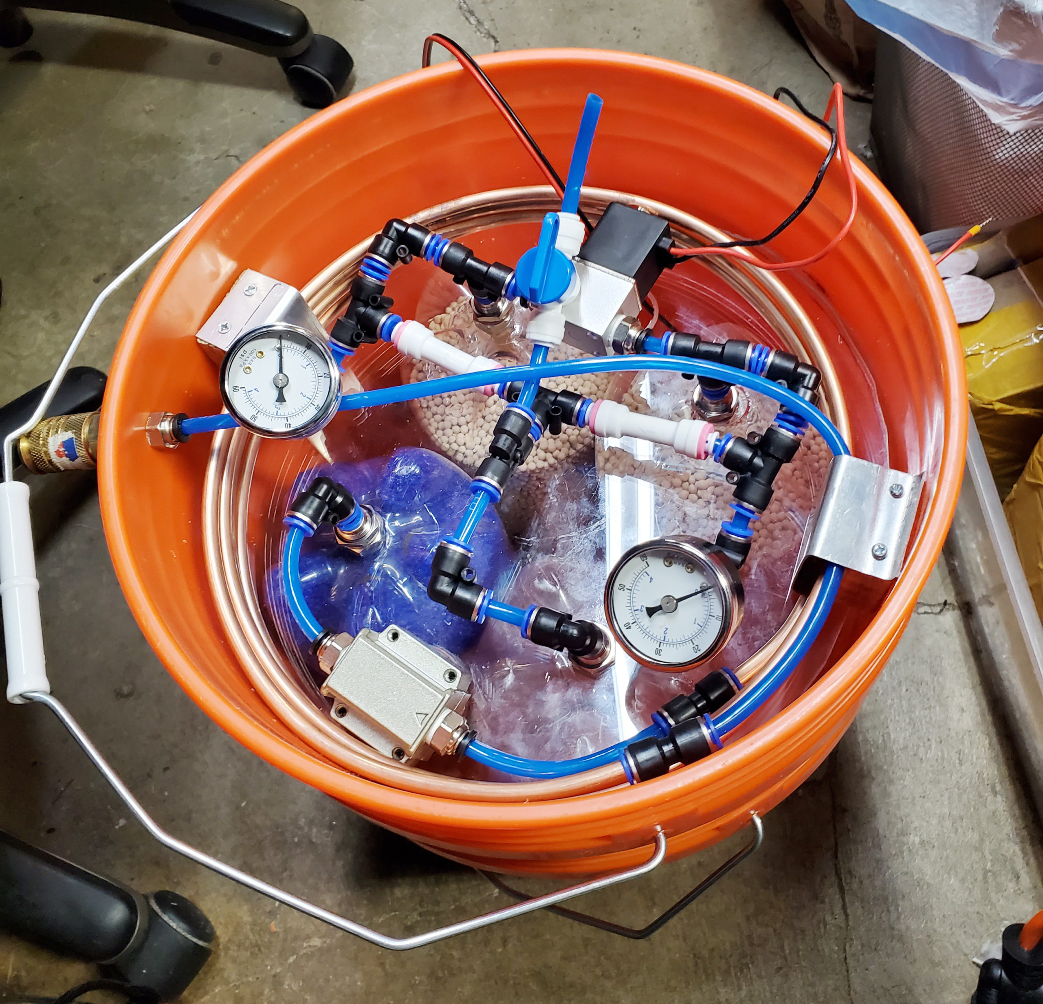
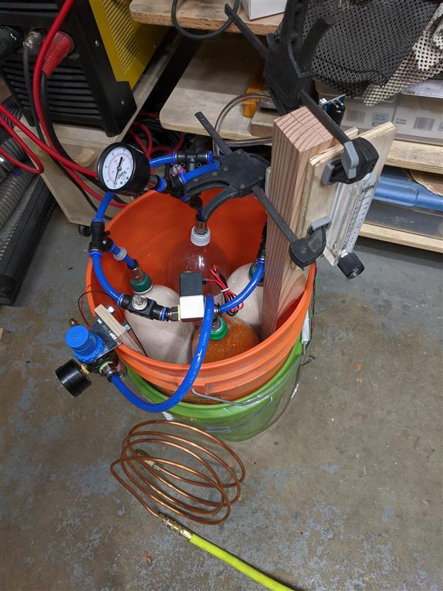
Project Apollo
What is it
Goal = enabling people around the world to build the prototype ASAP
Focus = Simplicity and speed of build
Simple, reliable design (zeolite-based PSA system)
Flexible, open source, off-the-shelf materials
Very low cost (aspirational target = $200 for 15 liters/min @ 80%)
Final goal = Enable people to iterate and publish their own designs in the community

Slide 3

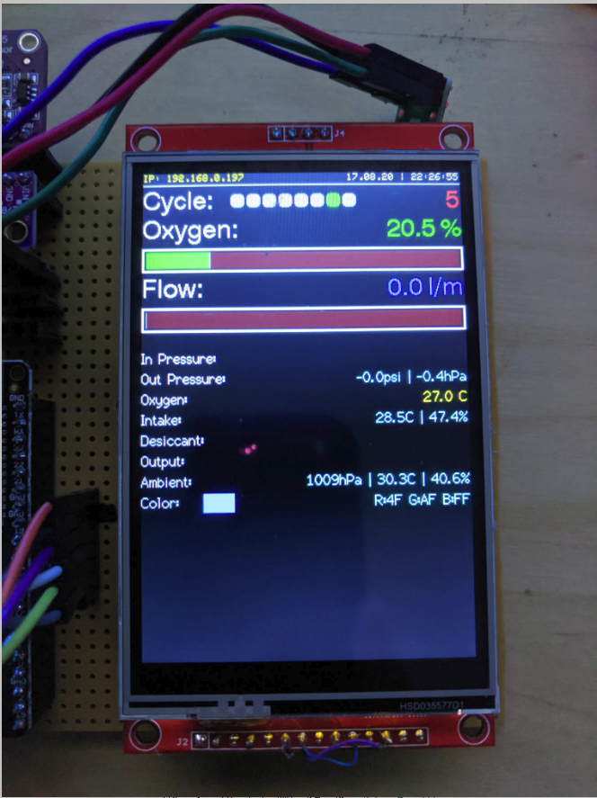
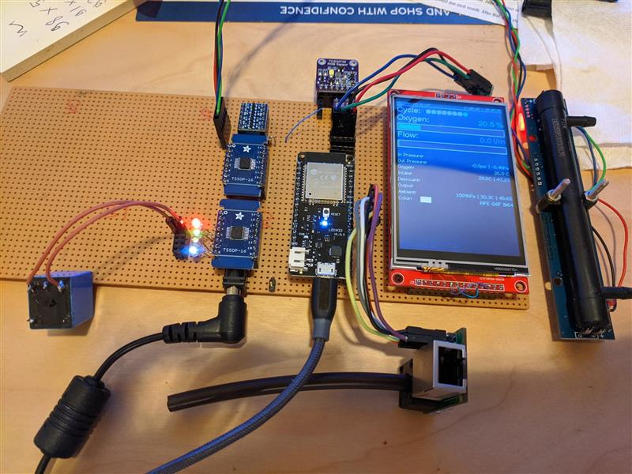
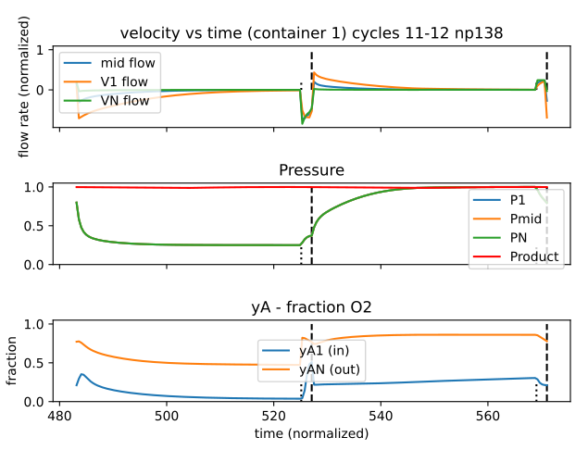
Project Apollo v4
Apollo v4
Focus = medical device
Safety: detect all failure scenarios
Ease of use: User experience and maintainability. Clear, actionable error messages
Self-regulating: Patient sensor/data feedback loop
Control box
Touch screen for diagnostic messages, medical-grade buzzer
Open source, modular PCB design. Works with a variety of sensors
Self-tuning: valve timing, auto-adjusts to changes in compressed air input pressure, machine learning
Integration with SpO2 oximeter Bluetooth sensor
Cloud data integration for patient monitoring
Self-contained enclosure
Built-in compressor
Multi-stage moisture removal
Full focus on thermals, airflow, noise reduction
Collaborations
Funding: Quick2space.org
Volunteers: Helpful Engineering, Microsoft Garage, Public Invention
Documentation, code
http://project-apollo.org

Slide 4
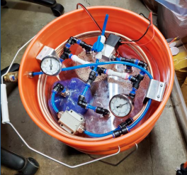
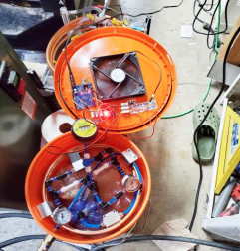
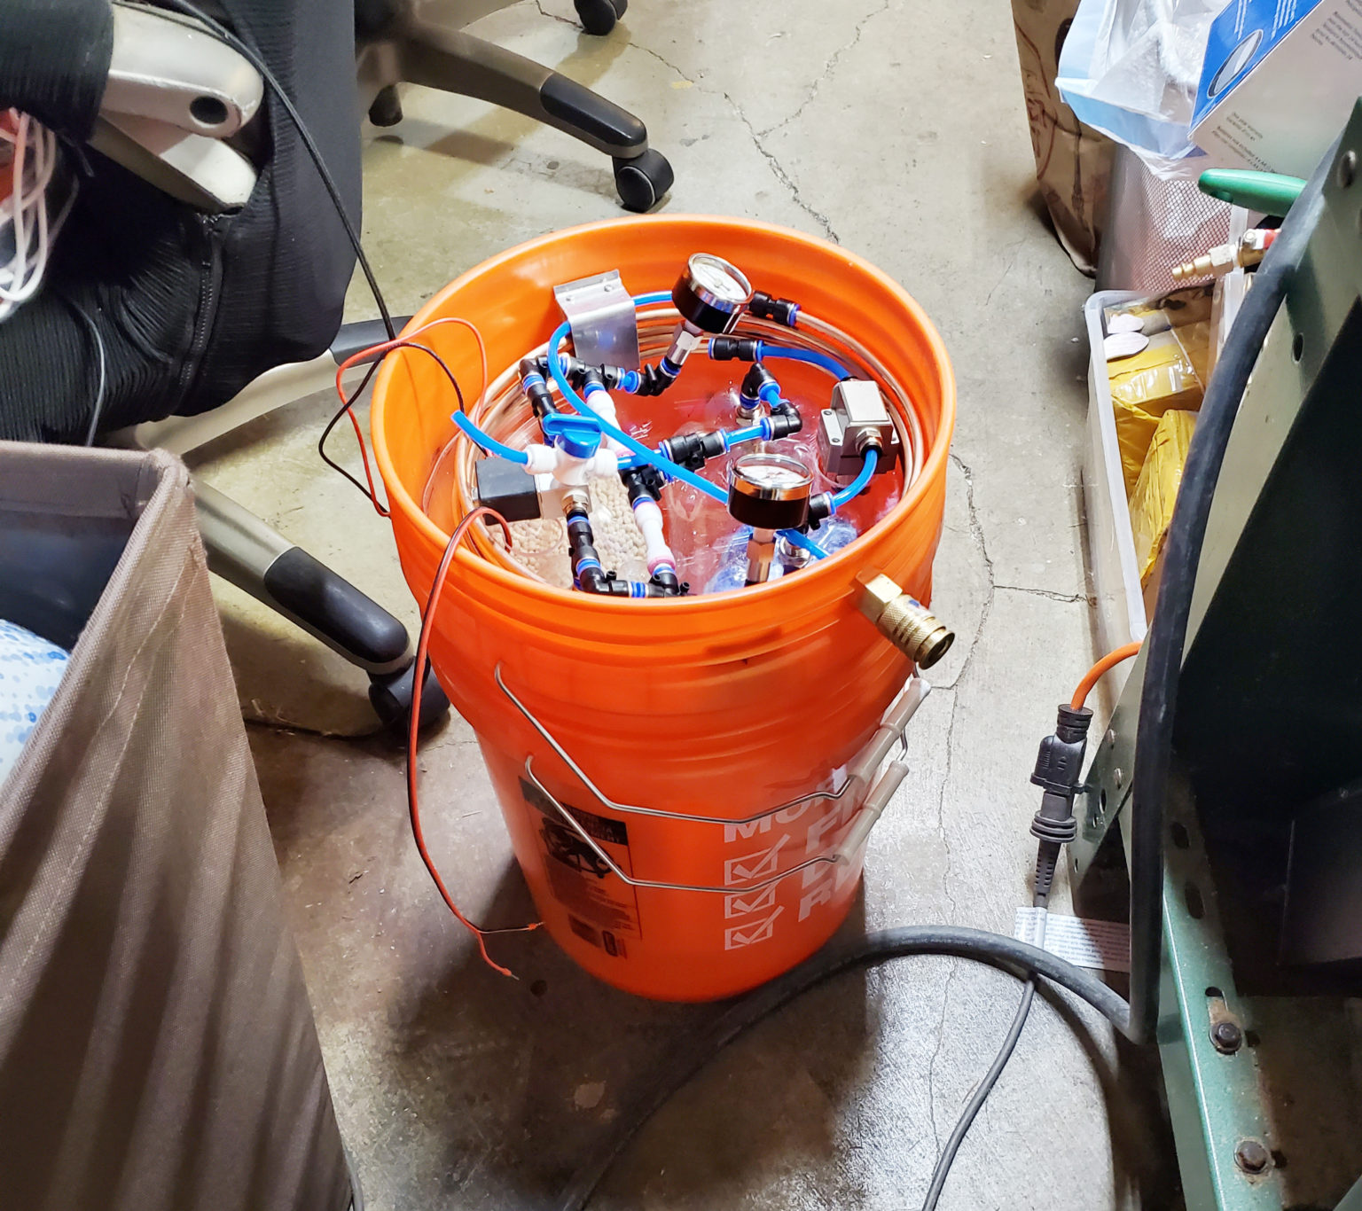
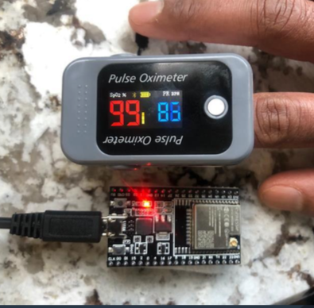
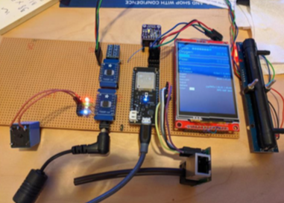
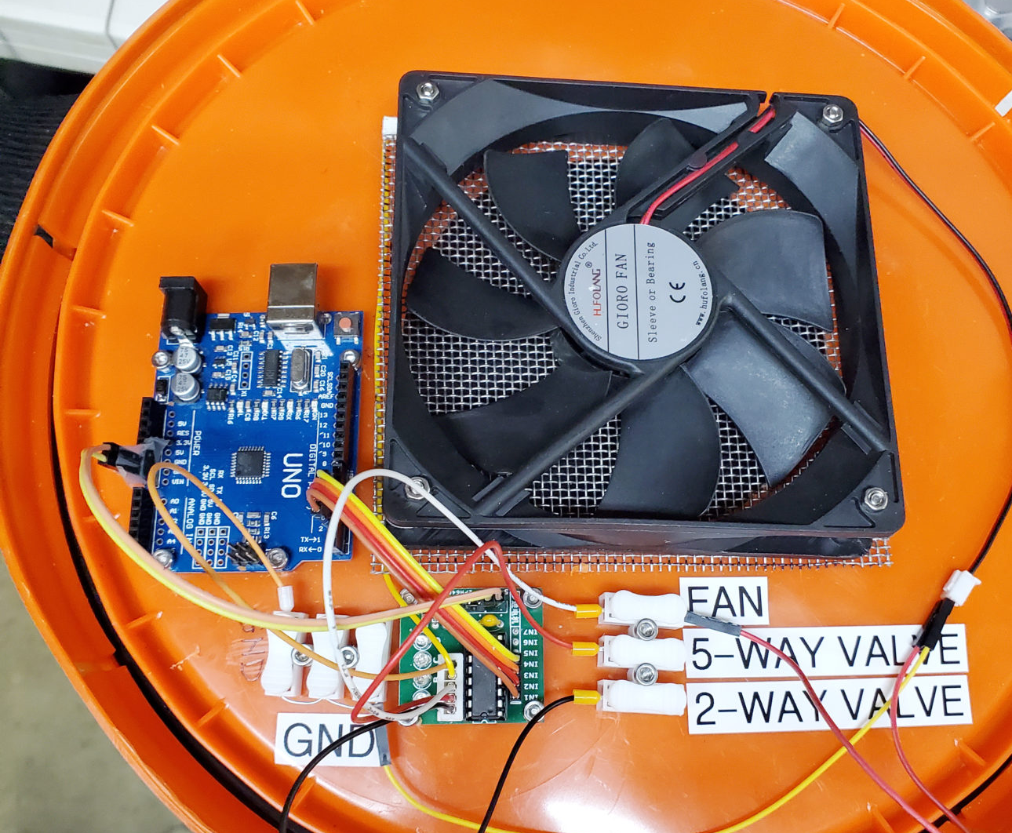
Project Apollo – conclusions
Description
O2 Concentrator: Simple, reliable design (zeolite-based PSA system). Flexible, open source, using off-the-shelf materials
Differentiators
Very low cost (aspirational target = $250 for 15 liters/min @ 90%) – current BOM cost range on prototypes have been $260-450 with retail ordered parts and components (not including cost of compressor and oxygen sensor) Safety & Usability: Detect all failure scenarios, User experience and maintainability. Clear, actionable error messages, Alarm sensors Self-regulating: Patient sensor/data feedback loop Touch screen for diagnostic messages, medical-grade buzzer, large 2.8" LED screen, localizable messages in any locale/character set Open source, modular PCB design. Works with a variety of sensors Self-tuning: valve timing, timing adapts in changes in temperature, variations in physical dimensions, zeolite age, auto-adjusts to changes in compressed air input pressure, machine learning. Integration with SpO2 oximeter Bluetooth sensor Cloud data integration for patient monitoring Built-in compressor, self contained enclosure – humidity and filtering, optimized airflow, thermals/cooling and noise reduction
Target: Product Quality Standards and Prototype Readiness
Compatible and adaptable with the Indian Supply Chain driven BOM Compliant with new Indian Govt. guidelines on O2 Concentrator Feature sets Can be assembled in a lead time of 4-5 hours given availability of parts

Slide 5





Project Apollo Partners, collaborators
Microsoft Garage

